Slide 1

Transaction
Computer System Engineering, Fall 2019. (IPADS, SJTU)
All-or-nothing & Before-or-after
Yubin Xia

Slide 2
The CAP Theory

Slide 3

从一则新闻说起
支付宝发生故障
断网：杭州光纤被挖断
不可用：2小时内瘫痪
疑问：为何不启用异地备份
支付宝在深圳有备份系统，断网情况下为何不进行实时的切换？
数据一致性很难保证
能否即保证网站的一致性、可用性，又能容忍区域性网络故障？

Slide 4
CAP理论：鱼与熊掌不可得兼
对分布式计算机系统来说，同时满足以下三点是不可能的：
Consistency：所有节点在同样的时间看见同样的数据
Availability：每个请求均可收到回复（成功或失败，而不是“不可用”）
Partition Tolerance：在任意消息丢失或一部分的系统故障情况下，系统依然可继续运行
CAP理论的历史
2010年：UC Berkeley的Eric Brewer教授首次提出
2012年：MIT的Seth Gilbert 和Nancy lynch证明了CAP的正确性

Slide 5
一致性（Consistency）
定义：所有用户在同一时间所看到的所有数据都是相同的
在数据有多个备份的情况下依然要保证这一点
数据不一致的情况
例如：对于同一列火车，北京用户看到还剩2个，上海用户看到还剩1个
例如：发了一条消息朋友圈，不同朋友看到的评论顺序不同
例如：用户A转账给用户B，显示成功后，再次刷新发现转账失败

Slide 6

可用性（Availability）
定义：系统对用户请求均有响应
在一定时间内回复处理成功或失败
可用状态
例如：“车票购买成功”，或“车票已售完”
不可用状态
例如：长时间显示“加载中”却没有任何进展
例如：电话提示“系统当前忙，请稍后重试”

Slide 7
AP与CP
P：通常是一个事实
网络连接通常不可依赖——挖断光纤如何100%避免？
选择一：牺牲Consistency（AP）
保证用户体验，用户总能操作成功，即使数据可能不一致
问题：如果一本书买给两个人，怎么办？
道歉然后给其中一个人coupon，对一致性的要求不高
问题：如果一张火车票买给两个人，怎么办？
AP不适合这种对一致性要求极高的场景

Slide 8
AP与CP
P：通常是一个事实
网络连接通常不可依赖——挖断光纤如何100%避免？
选择二：牺牲Availability（CP）
数据一致性的优先级更高，例如金融、火车票等
当发生区域性断网时，拒绝新的用户请求直到网络恢复
例如：支付宝的2小时瘫痪

Slide 9
C和A并不是0或1的选择
例如：一个CP系统在网络出现中断时，并非完全不可用
有两个区域欧洲和北美，网络断开后北美可以用，只有欧洲不可用
当网络恢复后，将北美的数据同步回欧洲，即北美为主，欧洲从属

Slide 10
Transaction

Slide 11
Our Goal
Goal: build reliable systems from unreliable components
This is difficult because reasoning about failures is difficult
We need some new abstractions that will let us simplify
All-or-nothing
Before-or-after

Slide 12
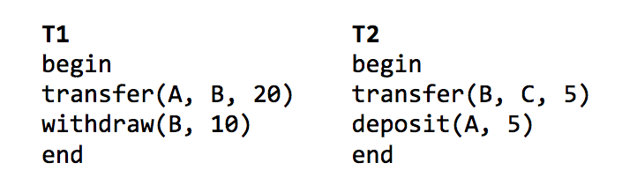
Transactions
All-or-nothing: T1 and T2 will each appear to have run to completion, or not at all
Before-or-after: When run concurrently, it will appear as if T1 and T2 were run sequentially
These two abstractions make it easier to reason about failures (and concurrency)

Slide 13
Atomicity: All-or-Nothing
An action is atomic if happens completely or not at all
If guarantee atomicity, it will be much easier to reason about failures
Need to think about the consequences of the action happening or not happening, but not about the action partially happening

Slide 14
Example: the IBM System/370
Multi-operand character-editing instruction
TRANSLATE contains 3 arguments
Two address: string and table, 8-bit counter: length
Takes 1 byte at a time from string, as an offset in table, get the byte in table, then replace the byte in string
Problem: page fault
Solution: dry run
Hidden copy of register make no change to memory
Maybe several dry run for one instruction, then run it again
Problem again: what if another process snatch a page?

Slide 15
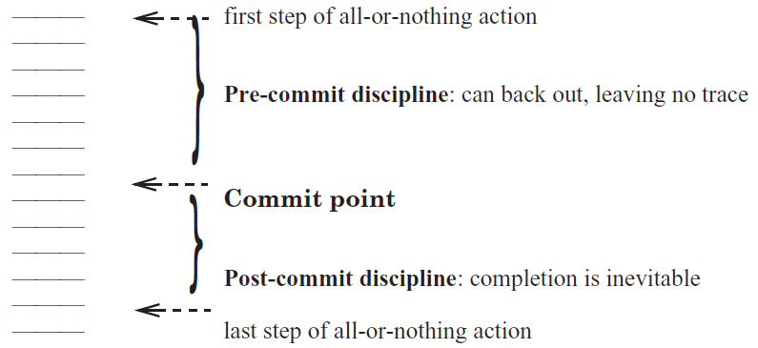
Commit Point

Slide 16
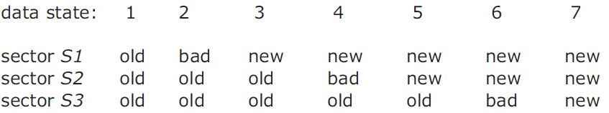
Commit Point
Where is the commit point?

Slide 17
Shadow Copy

Slide 18
Bank Account Transfer
audit(bank):
xfer(bank, a, b, amt):
bank[a] = bank[a] – amt
bank[b] = bank[b] + amt
audit(bank):
sum = 0
for acct in bank:
sum = sum + bank[acct]
return sum
<- sum=200
<- sum=150
<- sum=200
Notes:
Demo: stresses inconsistent behavior due to concurrency (i.e., audit)

Slide 19
Shadow Copy
xfer(bank, a, b, amt):
bank[a] = read_accounts(bankfile)
bank[a] = bank[a] – amt
bank[b] = bank[b] + amt
write_accounts(#bankfile)
rename("#bankfile", bankfile)
Notes:
Idea: write to a shadow copy of the file first, then rename file in one step.
[ slide: file xfer with shadow ]
Here, we assume rename() will replace existing bankfile with "newfile".
If system crashes before rename, bank contains old balances.
If system crashes after rename, bank contains new balances.
Of course, we need to ensure that only one operation runs at a time,
but we will talk about concurrency later.
We call the rename a "commit point".
Commit point: crash before gives old value, crash after gives new value.
Commit point must be itself an all-or-nothing action.
Need rename (our commit point) to have all-or-nothing atomicity..

Slide 20
rename("#bank", "bank")
Directory data blocks:
filename "bank" → inode 12
filename "#bank" → inode 13
inode 12:
data blocks: 3, 4, 5
refcount: 1
inode 13:
data blocks: 6, 7, 8
refcount: 1
Notes:
If crash, then refcount is wrong.

Slide 21
rename("#bank", "bank")
Directory data blocks:
filename "bank" → inode 13
filename "#bank" → inode 13
inode 12:
data blocks: 3, 4, 5
refcount: 1
inode 13:
data blocks: 6, 7, 8
refcount: 1
Notes:
If crash, then refcount is wrong.

Slide 22
rename("#bank", "bank")
Directory data blocks:
filename "bank" → inode 13
filename "#bank" → inode 13
inode 12:
data blocks: 3, 4, 5
refcount: 1
inode 13:
data blocks: 6, 7, 8
refcount: 2

Slide 23
rename("#bank", "bank")
Directory data blocks:
filename "bank" → inode 13
filename "#bank" → inode 13
inode 12:
data blocks: 3, 4, 5
refcount: 0
inode 13:
data blocks: 6, 7, 8
refcount: 2

Slide 24
rename("#bank", "bank")
Directory data blocks:
filename "bank" → inode 13
filename "#bank" → inode 13
inode 12:
data blocks: 3, 4, 5
refcount: 0
inode 13:
data blocks: 6, 7, 8
refcount: 2

Slide 25
rename("#bank", "bank")
Directory data blocks:
filename "bank" → inode 13
filename "#bank" → inode 13
inode 12:
data blocks: 3, 4, 5
refcount: 0
inode 13:
data blocks: 6, 7, 8
refcount: 1

Slide 26
Problem
Q: If crash, in what step will cause problem?
Two names point to fnew’s inode, but refcount is 1
Problem: which reference is the correct one?

Slide 27
Second Try: Increase ref-count First
rename(x, y):
newino = lookup(x)
oldino = lookup(y)
incref(newino)
change y's dirent to newino
decref(oldino)
remove x's dirent
decref(newino)
Notes:
We never have too few refcounts, but still might have too many.

Slide 28
rename("#bank", "bank")
Directory data blocks:
filename "bank" → inode 12
filename "#bank" → inode 13
inode 12:
data blocks: 3, 4, 5
refcount: 1
inode 13:
data blocks: 6, 7, 8
refcount: 2

Slide 29
rename("#bank", "bank")
Directory data blocks:
filename "bank" → inode 13
filename "#bank" → inode 13
inode 12:
data blocks: 3, 4, 5
refcount: 1
inode 13:
data blocks: 6, 7, 8
refcount: 2

Slide 30
rename("#bank", "bank")
Directory data blocks:
filename "bank" → inode 13
filename "#bank" → inode 13
inode 12:
data blocks: 3, 4, 5
refcount: 0
inode 13:
data blocks: 6, 7, 8
refcount: 2

Slide 31
rename("#bank", "bank")
Directory data blocks:
filename "bank" → inode 13
filename "#bank" → inode 13
inode 12:
data blocks: 3, 4, 5
refcount: 0
inode 13:
data blocks: 6, 7, 8
refcount: 2

Slide 32
rename("#bank", "bank")
Directory data blocks:
filename "bank" → inode 13
filename "#bank" → inode 13
inode 12:
data blocks: 3, 4, 5
refcount: 0
inode 13:
data blocks: 6, 7, 8
refcount: 1
Q: where is the commit point?
Notes:
Q: What's the commit point? Modifying y's dirent.
Q: What if we crash during the commit point writing to the dirent?
Assume that writing to one sector on disk is all-or-nothing.
An ideal disk saves enough energy to complete one sector write.
Time spent writing a sector is small (remember, high sequential speed).
Small capacitor suffices to power disk for a few microseconds.
If write didn't start, no need to complete it: still all-or-nothing.

Slide 33
Recovery After Crash
salvage(disk):
for inode in disk.inodes:
inode.refcnt =
find_all_refs(disk.root_dir, inode)
if exists("#bank"):
unlink(“#bank”)
Notes:
Fixing up after a crash: salvage.
If we crash, our commit point ensures we have all-or-nothing atomicity.
But we still have a bit of a mess left over because of the crash.
If we crashed before commit: extra refcount on inode 13.
If we crashed after commit: extra refcount on inode 12.
In both cases: directory entry for "newfile" can be removed.
[ slide: salvage function ]

Slide 34
Shadow Copy
Write to a copy of data, atomically switch to new copy
Switching can be done with one all-or-nothing operation (sector write)
Requires a small amount of all-or-nothing atomicity from lower layer (disk)
Main rule: only make one write to current/live copy of data
In our example, sector write for rename
Creates a well-defined commit point

Slide 35
Shadow Copy
Does the shadow copy approach work in general?
+ Works well for a single file
- Hard to generalize to multiple files or directories
Might have to place all files in a single directory, or rename subdirs
- Requires copying the entire file for any (small) change
- Only one operation can happen at a time
- Only works for operations that happen on a single computer, single disk

Slide 36
Logging for All-or-nothing

Slide 37
Example: Bank Account App (Shadow Copy)
xfer(bank, a, b, amt):
copy(bank, tmp)
tmp[a] = tmp[a] – amt
tmp[b] = tmp[b] + amt
rename(tmp, bank)

Slide 38
Transaction Terminology
xfer(bank, a, b, amt):
begin
bank[a] = bank[a] – amt
bank[b] = bank[b] + amt
if bank[a] < 0:
abort //Not enough funds
else:
commit
xfer(bank, a, b, amt):
begin
write (a, read(a) – amt)
write (b, read(b) – amt)
if read (a) < 0:
abort //Not enough funds
else:
commit
Notes:
not everything can be a transaction.

Slide 39
Consider the Bank Account Example
Two accounts: A and B
Accounts start out empty
Run these all-or-nothing actions
Problem
After crash, A=110, but T3 never committed
Solution
Revert to A’s previous committed value
T1 and T2: "All"
T3: "Nothing"
begin // T1
A = 100
B = 50
"commit // A=100; B=50
begin // T2
A = A - 20
B = B + 20
"commit // A=80; B=70
begin // T3
A = A + 30 // A=110
--CRASH--
Notes:
Logging: only record the delta.

Slide 40
A Log Sample
+-------+------+--------+-------+------+--------+-------+
TID | T1 | T1 | T1 | T2 | T2 | T2 | T3 |
OLD | A=0 | B=0 | | A=100 | B=50 | | A=80 |
NEW | A=100 | B=50 | COMMIT | A=80 | B=70 | COMMIT | A=110 |
+-------+------+--------+-------+------+--------+-------+
begin // T1
A = 100
B = 50
"commit // A=100; B=50
begin // T2
A = A - 20
B = B + 20
"commit // A=80; B=70
begin // T3
A = A + 30 // A=110
--CRASH--

Slide 41
Five Operations Involved
Begin
Write variable
Read variable
Commit
Abort

Slide 42
Five Operations Involved
1. begin: allocate a new transaction ID
2. write variable: append an entry to the log
3. read variable: scan the log looking for last committed value
As an aside: how to see your own updates?
Read uncommitted values from your own TID

Slide 43
Read
+-------+------+--------+-------+------+--------+-------+
TID | T1 | T1 | T1 | T2 | T2 | T2 | T3 |
OLD | A=0 | B=0 | | A=100 | B=50 | | A=80 |
NEW | A=100 | B=50 | COMMIT | A=80 | B=70 | COMMIT | A=110 |
+-------+------+--------+-------+------+--------+-------+
read(log, var):
commits = {}
// scan backwards
for record r in log[len(log) - 1] .. log[0]:
// keep track of commits
if r.type == commit:
commits.add(r.tid)
// find var’s last committed value
if r.type == update and
r.tid in commits and
r.var == var:
return r.new_value
Notes:
Q: Which is a commit point?
Assumption: writing a single disk block is atomic. A partially written record is ignored.

Slide 44
Read
+-------+------+--------+-------+------+--------+-------+
TID | T1 | T1 | T1 | T2 | T2 | T2 | T3 |
OLD | A=0 | B=0 | | A=100 | B=50 | | A=80 |
NEW | A=100 | B=50 | COMMIT | A=80 | B=70 | COMMIT | A=110 |
+-------+------+--------+-------+------+--------+-------+
read(log, var):
commits = {}
// scan backwards
for record r in log[len(log) - 1] .. log[0]:
// keep track of commits
if r.type == commit:
commits.add(r.tid)
// find var’s last committed value
if r.type == update and
（r.tid in commits or r.tid == current_tid) and
r.var == var:
return r.new_value
Notes:
Q: Which is a commit point?
Assumption: writing a single disk block is atomic. A partially written record is ignored.

Slide 45
Five Operations Involved
4. Commit: write a commit record
Expectedly, writing a commit record is the "commit point" for action, because of the way read works (looks for commit record)
However, writing log records better be all-or-nothing
One approach, from last time: make each record fit within one sector
5. Abort: Do nothing or write a record?
Could write an abort record, but not strictly needed
Recover from a crash: do nothing

Slide 46
Performance Problem of Log-only Approach
Write performance is probably good
Sequential writes, instead of random
Need to write to disk twice instead of once
Read performance is terrible!
Scan the log for every read!
Recovery is instantaneous
Nothing to do

Slide 47
Performance Optimization
Keep both a log and cell storage
Log as before: authoritative, provides all-or-nothing atomicity
Cell storage: provides fast reads, but cannot provide all-or-nothing
Both are stored on disk
Terminology
"log" an update when it's written to the log
"install" an update when it's written to cell storage
Notes:
[ board: log, cell storage; updates going to both, read from cell storage ]

Slide 48
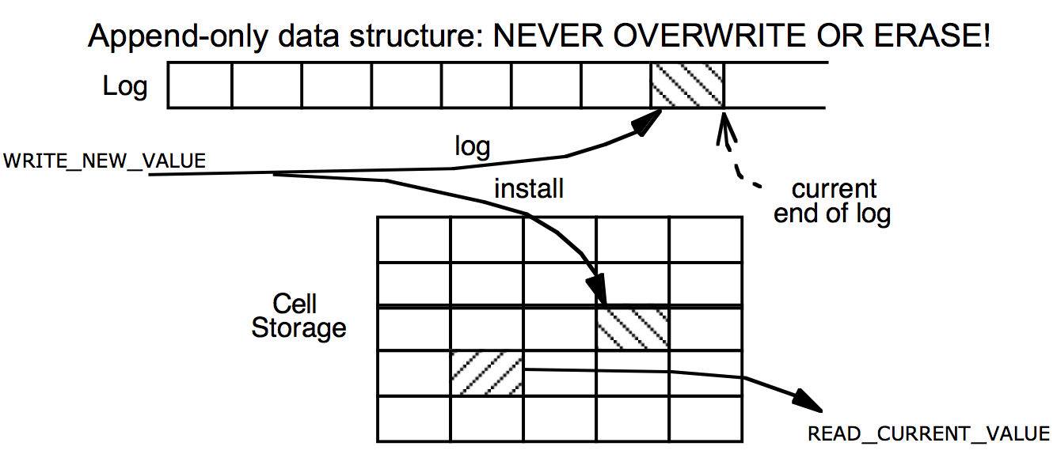
Cell Storage (Home) + Log Storage

Slide 49
Read / write with Cell Storage
Two questions we have to answer now:
How to update both the log and cell storage when an update happens?
How to recover cell storage from the authoritative log after crash?

Slide 50
Read / write with Cell Storage
+-------+------+--------+-------+------+--------+-------+
TID | T1 | T1 | T1 | T2 | T2 | T2 | T3 |
OLD | A=0 | B=0 | | A=100 | B=50 | | A=80 |
NEW | A=100 | B=50 | COMMIT | A=80 | B=70 | COMMIT | A=110 |
+-------+------+--------+-------+------+--------+-------+
Cell Storage
A 110
B 70
read(var):
return cell_read(var)
write(var, value):
log.append(cur_tid, update,
var, read(var), value)
cell_write(var, value)
Notes:
Recovery? Crash between logging and installing.
Write is not all-or-nothing! install value before commit? what if crash? Need to roll back to old value (which is saved in the log)
Log still contains the same things.
As we're running, maintain cell storage for A and B.
Except one problem: after crash, A's value in cell storage is wrong.
Last action aborted (due to crash), but its changes to A are visible.
We're going to have to repair this in our recovery function.
Good thing we have the log to provide authoritative information.

Slide 51
Order Matters
Ordering of logging and installing
The two together do not have all-or-nothing atomicity
Can crash in-between, so just one of the two might have taken place
What happens if we install first and then log?
If we crash, no idea what happened to cell storage, or how to fix it
The rule for logging is the "Write-ahead-log protocol" (WAL)
Log the update before installing it
If we crash, log is authoritative and intact, can repair cell storage
Can think of it as not being the only copy, once it's in the log

Slide 52
Recovering Cell Storage
What happens if we log an update, install it, but then abort/crash?
Need to undo that installed update
Plan: scan log, determine what actions aborted ("losers"), undo them
Why do we have to scan backwards?
Need to undo newest to oldest
Also need to find outcome of action before we decide whether to undo

Slide 53
Recovery with Cell Storage
+-------+------+--------+-------+------+--------+-------+
TID | T1 | T1 | T1 | T2 | T2 | T2 | T3 |
OLD | A=0 | B=0 | | A=100 | B=50 | | A=80 |
NEW | A=100 | B=50 | COMMIT | A=80 | B=70 | COMMIT | A=110 |
+-------+------+--------+-------+------+--------+-------+
Cell Storage
A 110
B 70
commits = {}
recover(log):
commits = {}
for record r in log[len(log)-1] .. log[0]:
if r.type == commit:
commits.add(r.tid)
if r.type == update and r.tid not in commits:
cell_write(r.var, r.old_val) // undo
Notes:
Recovery? Crash between logging and installing.
Write is not all-or-nothing! install value before commit? what if crash? Need to roll back to old value (which is saved in the log)
Log still contains the same things.
As we're running, maintain cell storage for A and B.
Except one problem: after crash, A's value in cell storage is wrong.
Last action aborted (due to crash), but its changes to A are visible.
We're going to have to repair this in our recovery function.
Good thing we have the log to provide authoritative information.

Slide 54
Recovery with Cell Storage
+-------+------+--------+-------+------+--------+-------+
TID | T1 | T1 | T1 | T2 | T2 | T2 | T3 |
OLD | A=0 | B=0 | | A=100 | B=50 | | A=80 |
NEW | A=100 | B=50 | COMMIT | A=80 | B=70 | COMMIT | A=110 |
+-------+------+--------+-------+------+--------+-------+
Cell Storage
A 80
B 70
commits = {}
recover(log):
commits = {}
for record r in log[len(log)-1] .. log[0]:
if r.type == commit:
commits.add(r.tid)
if r.type == update and r.tid not in commits:
cell_write(r.var, r.old_val) // undo
Notes:
Recovery? Crash between logging and installing.
Write is not all-or-nothing! install value before commit? what if crash? Need to roll back to old value (which is saved in the log)
Log still contains the same things.
As we're running, maintain cell storage for A and B.
Except one problem: after crash, A's value in cell storage is wrong.
Last action aborted (due to crash), but its changes to A are visible.
We're going to have to repair this in our recovery function.
Good thing we have the log to provide authoritative information.

Slide 55
Recovery with Cell Storage
+-------+------+--------+-------+------+--------+-------+
TID | T1 | T1 | T1 | T2 | T2 | T2 | T3 |
OLD | A=0 | B=0 | | A=100 | B=50 | | A=80 |
NEW | A=100 | B=50 | COMMIT | A=80 | B=70 | COMMIT | A=110 |
+-------+------+--------+-------+------+--------+-------+
Cell Storage
A 80
B 70
commits = {T2}
recover(log):
commits = {}
for record r in log[len(log)-1] .. log[0]:
if r.type == commit:
commits.add(r.tid)
if r.type == update and r.tid not in commits:
cell_write(r.var, r.old_val) // undo

Slide 56
Recovery with Cell Storage
+-------+------+--------+-------+------+--------+-------+
TID | T1 | T1 | T1 | T2 | T2 | T2 | T3 |
OLD | A=0 | B=0 | | A=100 | B=50 | | A=80 |
NEW | A=100 | B=50 | COMMIT | A=80 | B=70 | COMMIT | A=110 |
+-------+------+--------+-------+------+--------+-------+
Cell Storage
A 80
B 70
commits = {T2, T1}
recover(log):
commits = {}
for record r in log[len(log)-1] .. log[0]:
if r.type == commit:
commits.add(r.tid)
if r.type == update and r.tid not in commits:
cell_write(r.var, r.old_val) // undo

Slide 57
Performance Now
Writes might still be OK
but we do write twice: log & install
Reads are fast
just look up in cell storage
Recovery requires scanning the entire log
Remaining performance problems:
We have to write to disk twice
Scanning the log will take longer and longer, as the log grows

Slide 58
Optimization 1: Improve Writes
Storing installing in a (volatile) cache, e.g., memory
Writes can now be fast: just one write, instead of two
Hope that variable is modified several times in cache before flush
Reads can also be benefited
Reads go through the cache, since cache may contain more up-to-date values

Slide 59
Read & Write with Cache
+-------+------+--------+-------+------+--------+-------+
TID | T1 | T1 | T1 | T2 | T2 | T2 | T3 |
OLD | A=0 | B=0 | | A=100 | B=50 | | A=80 |
NEW | A=100 | B=50 | COMMIT | A=80 | B=70 | COMMIT | A=110 |
+-------+------+--------+-------+------+--------+-------+
Cell Storage
A 110
B 70
Cache
A 110
B 70
recover(log):
commits = {}
for record r in log[len(log)-1] .. log[0]:
if r.type == commit:
commits.add(r.tid)
if r.type == update and r.tid not in commits:
cell_write(r.var, r.old_val) // undo
for record r in log[0] .. log[len(log)-1]:
if r.type == update and r.tid in commits:
cell_write(r.var, r.new_value) // redo

Slide 60
Problem Brought by Cache
Atomicity problem: cell storage (on disk) may be out-of-date
Is it possible to have changes that should be in cell storage, but aren't?
Yes: might not have flushed the latest commits
Is it possible to have changes that shouldn't be in cell storage, but are?
Yes: flushed some changes that then aborted (same as before)
Solution: change the recover procedure
Need a redo phase in addition to an undo phase in recovery
Don't treat actions with an abort record as "done"
There might be leftover changes from them in cell storage

Slide 61
Recover with Cache
+-------+------+--------+-------+------+--------+-------+
TID | T1 | T1 | T1 | T2 | T2 | T2 | T3 |
OLD | A=0 | B=0 | | A=100 | B=50 | | A=80 |
NEW | A=100 | B=50 | COMMIT | A=80 | B=70 | COMMIT | A=110 |
+-------+------+--------+-------+------+--------+-------+
Cell Storage
A 110
B 70
Cache
A 110
B 70
read(var):
if var in cache:
return cache[var]
else: // may evict others from cache to cell storage
cache[var] = cell_read(var)
return cache[var]
write(var, value):
log.append(current_tid, update, var, read(var), value)
cache[var] = value

Slide 62
Optimization 2: Truncate the Log
Current log grows without bound: not practical
What part of the log can be discarded?
Must know the outcome of every action in that part of log
Cell storage must reflect all of those log records (commits, aborts).
Truncating mechanism (assuming no pending actions):
Flush all cached updates to cell storage
Write a checkpoint record, to save our place in the log
Truncate log prior to checkpoint record
(Often log implemented as a series of files, so can delete old log files)
With pending actions, delete before checkpoint & earliest undecided record

Slide 63
Checkpointing
Doing the following:
1. Stop accepting new transactions
2. Wait until all current transactions commit or abort and have written the COMMIT or ABORT to the log
3. Flush the log to disk
4. Write a log record <CKPT> and flush the log again
5. Resume accepting transactions
No need to look in the log file prior to the last checkpoint

Slide 64
Non-quiescent Checkpointing
The problem with checkpointing:
Need to stop the system until all current operations have committed or aborted
Non-quiescent checkpointing:
1. Write a record <START CKPT(T1…Tk)> and flush log (T1,…Tk are the active transactions)
2. Wait until all of T1, … Tk commit or abort, but allow new transactions to start
3. When all of T1,…Tk have written COMMIT or ABORT, then write <END CKPT> to the log

Slide 65
Non-quiescent Checkpointing
If crash, then look backwards for the first <START CKPT(T1…Tk)> or <END CKPT>
If see an <END CKPT>, only have to consider after this
If see a <START CKPT(T1…Tk)> but no <END CKPT>, then only need to consider after the transactions T1, .. Tk began

Slide 66
Optimization-3: External Synchronous I/O
Problem: flush to disk is slow
Lazy writing, even for the log file
Some app, e.g., database, calls sync() to ensure flushing
But sync() is slow…
Solution: External Sync
Once the kernel return from sync(), the file may not be flushed
It will be flushed if something externally visible happens
E.g., print to the user, network sending, serial port outcome, etc.
Rethink the Sync, OSDI 2004

